Slide 1
Welcome to R/Medicine 101: Intro to R for Clinicians
Stephan Kadauke
R/Medicine 2020
Notes:
*

Slide 2
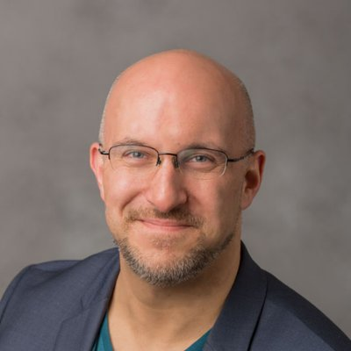
Stephan
Notes:
Chair of R/Medicine 2020 Organizing Committee and am leading this workshop. I am an Assistant Professor of Pathology and Laboratory Medicine at the Children’s Hospital of Philadelphia.

Slide 3

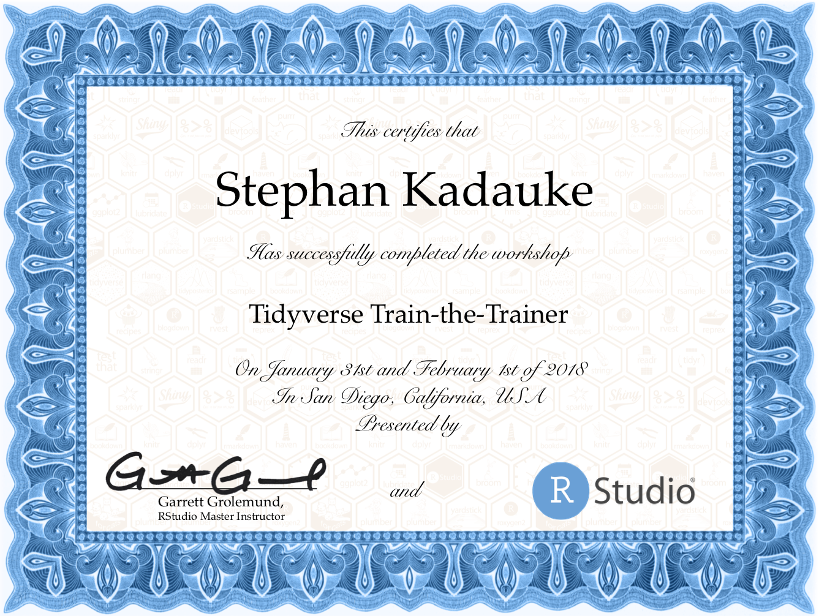
Notes:
I’ve been coding in R for 10+ years, and I’m an RStudio Certified trainer. I have taught R to physicians and other healthcare workers at the Harvard Massachusetts General Hospital, at the University of Pennsylvania, and at various conferences, both online and offline.

Slide 4
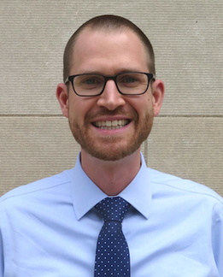
Joe
Notes:
I am joined today by two co-instructors. Joe Rudolf is an Assistant Professor of Pathology at the University of Utah. After this short orientation, Joe will take over with an Introduction to R, RStudio, and R Markdown.

Slide 5
Amrom
Notes:
And last but not least, Amrom Obstfeld. Amrom is an Assistant Professor of Pathology and Laboratory Medicine at the Children’s Hospital of Philadelphia. He will talk about Data Transformation.

Slide 6
Introducing the TAs!
Daniella Mark
Mohamed El Fodil Ihaddaden
Silvia Canelon
Shelmith Kariuki
Sina Rüeger
Amit Kohli
Richard Hanna
Shannon Hagerty
Martin Frigaard
Daniel Chen
Cass Wilkinson Saldaña
Peter Higgins
Bárbara Bitarello
Paul Wildenhain
Jake Riley
Amy Goodwin Davies
Zach Dravis

Slide 7
Orientation to the Technology

Slide 8

Main session vs Breakout rooms
Webinar-style
100+ participants
Mic off
Camera off
Meeting-style
10-15 participants / room
Mic on
Camera optional

Slide 11
[Section]

Slide 12
Your Turn #1
Use green Tw Cen MT 44 for text
Use blue Monaco 36 for code
Be explicit about mode of feedback (e.g.: Click “yes” when you are finished.)
To pick a timer, click Home > Layout > select the desired slide layout.

Slide 13
R Markdown
Notes:
(Might wan to mention here – next few min will be background and not critical to understand the rest, so if there are issues with logging into the server, please have TAs help troubleshooting now.)

Slide 14



Recap
Write 1-2 sentences to recap each major point of the session
Have a visual representing the section to the left
Notes:
To recap what we covered up to this point, …
(**) Analyzing data with with Excel, or similar spreadsheet software, can compromise data quality, and may ultimately lead to patient harm. This is because Excel does not record user interactions and it’s easy to make simple errors that can be very difficult to uncover later.
(**) Instead, you could use a reproducible workflow in which the entire analysis is automated with computer code, and we looked at how doing that can improve your confidence in the validity of an analysis.
(**) and finally, we defined “computational document” as documents that have executable code inside of them and we went over how computational documents are a key ingredient of reproducible workflows.

Slide 15
What else?
Notes:
The “What Else?” section should mention things that would be covered in a comprehensive course and/or are of strong interest to the intended audience

Slide 16
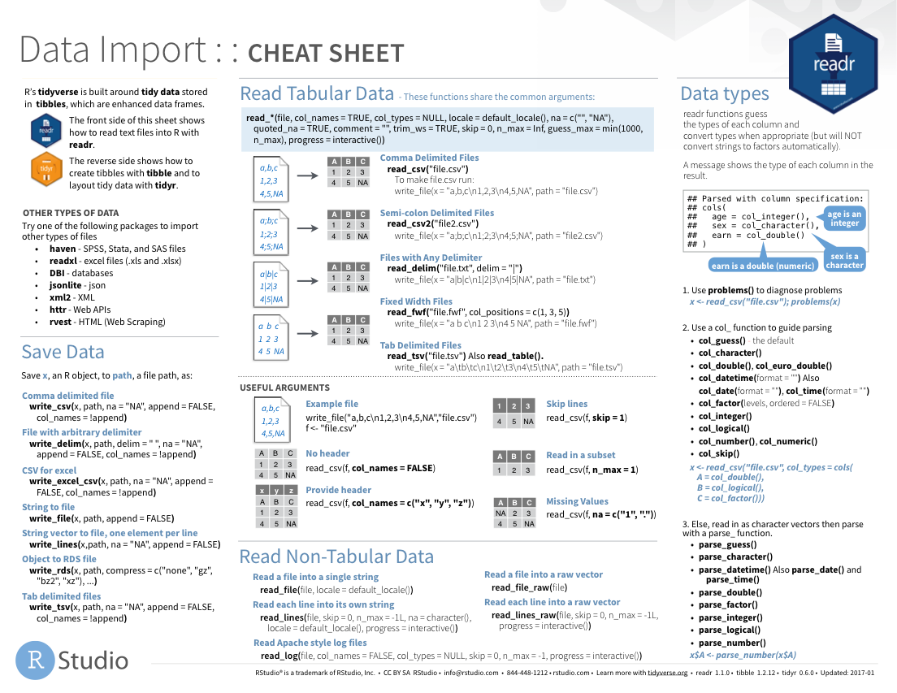
Notes:
Cheat sheets would go here

Slide 17
Notes:
As would other packages that do things

